Slide 1
A Case study on “Motion Pictures Data Analysis”
By
Kavindra Raj
(DS12S1)

Slide 2
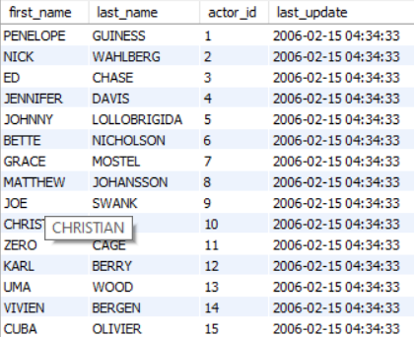
TASK 1:
The Sakila rental Store management wants to know the names of all the actors in their movie collection . Display the first names , last names , actor IDs and the details of the Last_updated column.
Query Used :
select actor.first_name,actor.last_name,actor.actor_id,actor.last_update from actor inner join film_actor inner join inventory inner join rental on actor.actor_id=film_actor.actor_id and film_actor.film_id=inventory.film_idand inventory.inventory_id=rental.inventory_id group by actor_id;
OUTPUT:

Slide 4
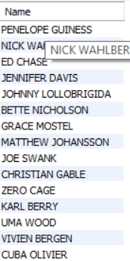
TASK 2:
Many actors have adopted attractive screen names, mostly at the behest of producers and directors .
The management wants to know the following :
Display the full names of all actors.
QUERY USED:
select concat(first_name,' ',Last_name) as Name from actor;
OUTPUT:

Slide 6
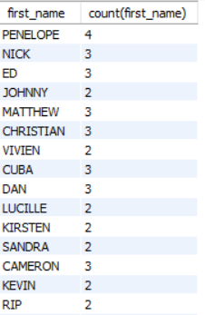
b. Display the first names of actors along with the count of repeated first names.
QUERY USED:
select first_name,count(first_name) from actor group by first_name having count(first_name)>1;
OUTPUT:

Slide 7
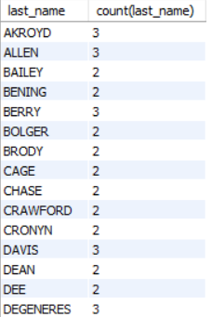
c. Display the last name of actors along with the count of repeated last names.
QUERY USED:
select last_name,count(last_name) from actor group by last_name having count(last_name)>1;
OUTPUT:

Slide 8
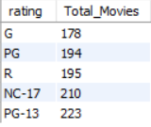
TASK 3:
Display the count of movies grouped by the ratings.
QUERY USED:
select rating,count(film_id) as Total_Movies from film group by rating order by count(film_id);
OUTPUT:

Slide 10
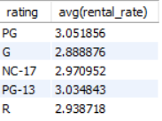
TASK 4:
Calculate and display the average rental rates based on the movie ratings.
QUERY USED:
select rating, avg(rental_rate) from film group by rating;

Slide 11
TASK 5:
The management wants the data about the replacement cost of movies . Replacement cost is the amount of money required to replace an existing asset (DVD/blue ray disc) with an equally valued or similar asset at the current market price.
Display the movie titles where the replacement cost is up to $8.
QUERY USED:
select title,replacement_cost from film where replacement_cost<=8;
OUTPUT:

Slide 12
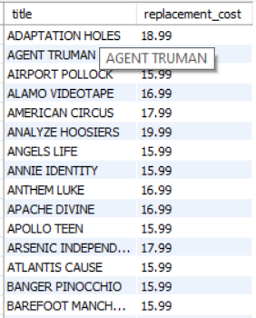
b. Display the movie titles where the replacement cost is between $15 and $20.
QUERY USED:
select title,replacement_cost from film where replacement_cost between 15 and 20;
OUTPUT:

Slide 13
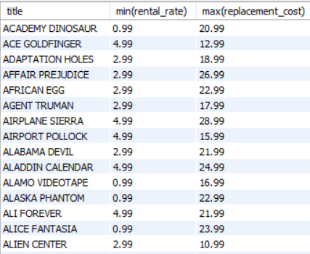
c. Display the movie titles with the highest replacement cost and the lowest rental cost.
QUERY USED:
select title,min(rental_rate),max(replacement_cost) from film group by title;
OUTPUT:

Slide 14
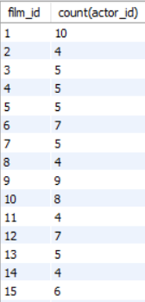
TASK 6:
The management needs to know the list all the movies . Along with the number of actors listed for each movie.
QUERY USED:
select film_id,count(actor_id) from film_actor group by film_id;
OUTPUT:

Slide 15
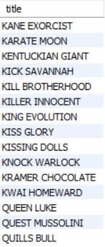
TASK 7:
The Music of Queen and Kris Kristofferson has seen an unlikely resurgence. As an unintended consequence , movies starting with the letters ‘K’ and ‘Q’ have also soared in popularity . Display the movie titles starting with the letters
‘K’ and ‘Q’ .
QUERY USED:
select title from film where title like ('K%') or ('Q%');
OUTPUT:

Slide 16
Output Data of Task 7

Slide 17
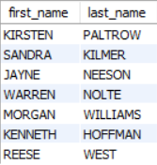
TASK 8:
The movie “AGENT TRUMAN’ has been a great success. Display the first names and last names of all actors who are a part of this movie
QUERY USED:
select actor.first_name,actor.last_name from actor join film join film_actor on actor.actor_id=film_actor.actor_idand film_actor.film_id=film.film_id where title like '%Agent Truman%';
OUTPUT:

Slide 18
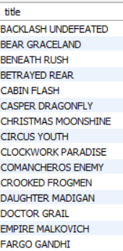
TASK 9:
Sales has been down among the family audience with kids. The management wants to promote the movies that fall under the ‘Children’ category. Identify and display the names of the movies in the family category.
QUERY USED:
select film.title from category join film join film_category on category.category_id=film_category.category_id and film_category.film_id= film.film_id where category.name like 'children';
OUTPUT:

Slide 19
Output Data of Task 9

Slide 20
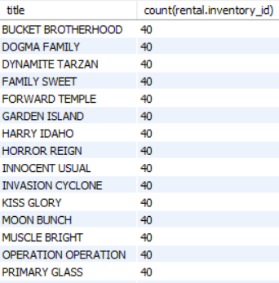
TASK 10:
Display the most frequently rented movies in descending order , so that The management can maintain more copies of such movies.
QUERY USED:
select film.title,count(rental.inventory_id) from film inner join inventory inner join rental on film.film_id=inventory.film_id and inventory.film_id=rental.inventory_id group by title order by count(rental.inventory_id) desc ;
OUTPUT:

Slide 21
Output Data of Task 10

Slide 22
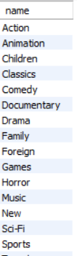
TASK 11:
Calculate and display the number of movie categories where the average difference between the movie replacement cost and the rental is Greater than $15.
QUERY USED:
select category.name from film join category join film_category on film.film_id=film_category .film_id and category.category_id=film_category.category_id group by category.name having avg(replacement_cost-rental_rate)>15;
OUTPUT:

Slide 23
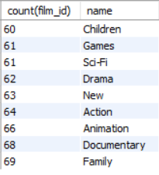
TASK 12:
The management wants to identify all the genres that consist of 60-70 Movies . The genre details are captured in the category column . Display the names of these categories/genres and the number of movies per Category/genre , sorted by the number of movies.
QUERY USED:
select count(film_id),category.name from film_category join category on category.category_id=film_category.category_id group by category.name having count(film_id) between 60 and 70 order by count(film_id);
OUTPUT:

Slide 25
CONCLUSION
Most popular first name is Penelope.
Most number of movies are in PG-13 and NC-17 Category.
PG rating Category has the highest rental rate.
Film title “ Lambs Cincinatti” having rating as PG-13 has the highest number of actors being part of it.
Sports and Foreign genre are the genre with highest revenue figures.

Slide 26
Thank You

